Slide 1

Exploring Cross-Application Cellular Traffic Optimization with Baidu TrafficGuard
Zhenhua Li, Weiwei Wang, Tianyin Xu, Xin Zhong,
Xiang-Yang Li, Yunhao Liu, Christo Wilson, and Ben Y. Zhao

Slide 2
China has the world’s largest population of mobile cellular users.
508.5
178
Source: www.eMarketer.com

Slide 3
China’s mobile users have notably small cellular data plan.
69.1% have no more than 200MB.
93.6% of China’s users have no more than 500MB of traffic plan per month.
Source: iMedia Research

Slide 4
Traffic overage is pervasive in China.
Unknown(2.1%)
Not at all (23.7%)
Severe (25.8%)
59.1% of China’s cellular users overuse their data plan.
Balanced (15.1%)
Slight (33.3%)
Source: iMedia Research

Slide 5
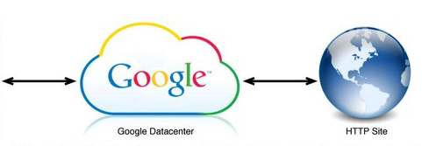

Efforts towards optimizing mobile traffic
Application-specific data compression
Flywheel: Google’s data compression proxy (NSDI’15)
Chrome browser
Flywheel
HTTP sites
→ transcode images to the WebP format
→ minify and gzip text content
50+% of mobile traffic reduction with moderate latency penalty.

Slide 6
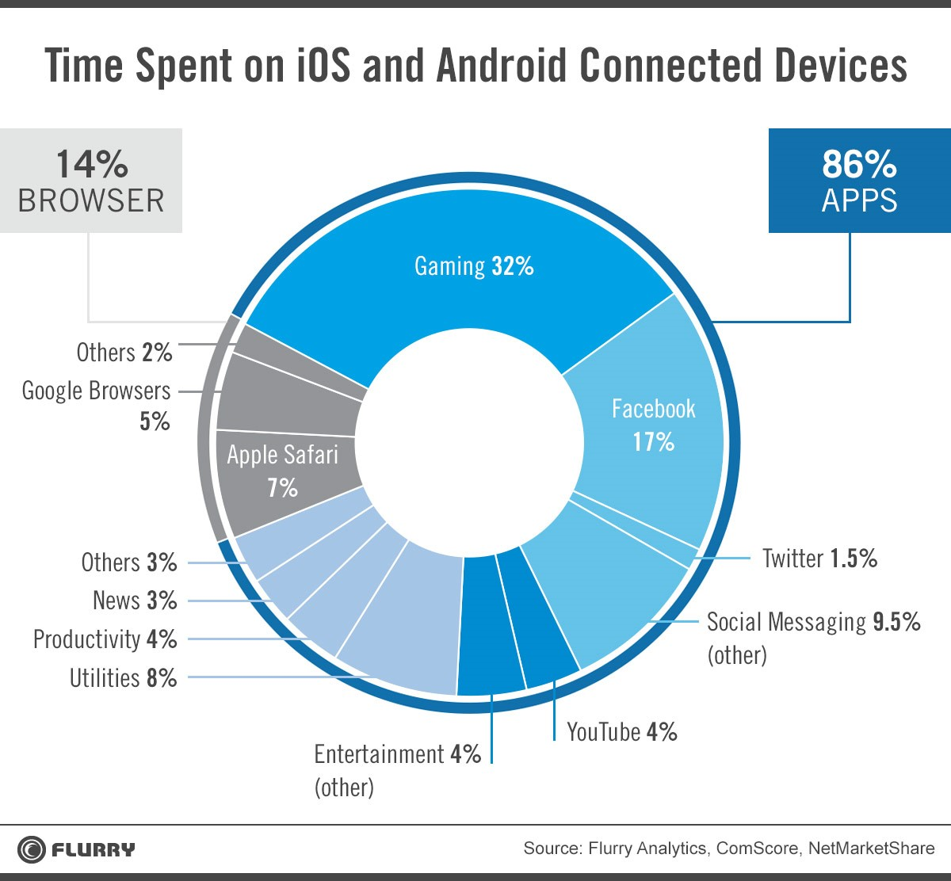

Mobile web browser traffic is only a (small) portion of today’s cellular traffic.

Slide 7
Baidu TrafficGuard
Optimizing cross-app cellular traffic
- data compression
- content validation
- cross-app caching
Filtering out unwanted traffic
- malicious/ads/overnight traffic
Two years of deployment experience
- 10 millions of users & 0.2 millions of active users daily
- support all Android 4.0+ devices

Slide 8





TrafficGuard Overview
① Handle all cellular
traffic across all apps
Backend
Proxy
Software middlebox
+
GET /
RESP
HTTP
② Filter out unwanted
traffic (e.g., malicious)
TG mobile app
In China, HTTP requests dominate the mobile web requests (80%).

Slide 9

TG mobile app (client-side support)
Apps
Customized VPN
- based on TUN
- manipulate layer-3 packets at
user space
- no root privilege required
Cooperation w/ the backend
- Local filter for malicious links
- Value-based cross-app caching
User space
Kernel
TCP/IP
TUN
NIC
Cellular network

Slide 10
Backend: web proxy + software middleboxes
Traffic reduction mechanisms
Traffic filtering*
Content validation
Cross-app
caching*
Data compression
*cooperate w/ the client-side TG mobile app

Slide 11
Backend: web proxy + software middleboxes
Traffic reduction mechanisms
Traffic filtering*
Content validation
Cross-app
caching*
Data compression
*cooperate w/ the client-side TG mobile app

Slide 12
Data compression
Characteristics of HTTP content types
Content Type | % HTTP Requests | % HTTP Traffic | Size (KB) Median Mean
Text | 49.0% | 15.7% | 0.2 | 2.2
Image | 32.0% | 71.0% | 5.7 | 15.5
Octet-stream | 10.0% | 5.5% | 0.4 | 3.8
Zip | 8.1% | 5.1% | 0.5 | 4.3
Audio & video | 0.03% | 2.6% | 407 | 614
Other | 0.87% | 0.1% | 0.3 | 0.7
*Text: HTML, CSS, JSON, XML, JS, etc

Slide 13
Text compression
Text compression is not worthwhile.
→ very small in size (mean: 0.2KB)
→ reduce HTTP traffic by 1.4%
→ considerable computation overhead at both
client and cloud side.
TrafficGuard does not compress text objects.

Slide 14
Image compression
71% of HTTP traffic are images, and 40% of
these images are oversized.
Challenges:
→ cannot transcode all the images to WebP (Flywheel’s
approach) because not all existing apps support WebP
→ cannot use WebP as the transfer format as the client-side
transcoding overhead is not acceptable
→ cannot simply rescale images which may distort
UI layout and degrade UX

Slide 15
Image compression
71% of HTTP traffic are images, and 40% of
these images are oversized.
Challenges:
→ cannot transcode all the images to WebP (Flywheel’s
approach) because not all existing apps support WebP
→ cannot use WebP as the transfer format as the client-side
transcoding overhead is not acceptable
→ cannot simply rescale images which may distort
UI layout and degrade UX

Slide 16
Image compression
71% of HTTP traffic are images, and 40% of
these images are oversized.
Challenges:
→ cannot transcode all the images to WebP (Flywheel’s
approach) because not all existing apps support WebP
→ cannot use WebP as the transfer format as the client-side
transcoding overhead is not acceptable
→ cannot simply rescale images which may distort
UI layout and degrade UX

Slide 17
Image compression
Adjusting the quality of the images by tuning QF (Quality Factors) of JPEG images
114KB (100%)
101KB (88%)
84KB (75%)
JPEG: 500×375
Median QF = 80
75 | 60 | 45
QF | 30 | 15
70KB (61%)
48KB (42%)

Slide 18
Image compression
Adjusting the quality of the images by tuning QF (Quality Factors) of JPEG images
→ categorize images into Large, Medium, Small, & Tiny
- based on the Ziproxy standard
→ tune QF to balance compression ratio and quality
- quality is measured by SSIM (Structural Similarity)
→ transcode PNG & GIF to JPEG if possible
- 8-10 times smaller overhead than WebP transcoding
- 59.9% of the images are in JPEG

Slide 19
Image compression
Adjusting the quality of the images by tuning QF (Quality Factors) of JPEG images
→ categorize images into Large, Medium, Small, & Tiny
- based on the Ziproxy standard
→ tune QF to balance compression ratio and quality
- quality is measured by SSIM (Structural Similarity)
→ transcode PNG & GIF to JPEG if possible
- 8-10 times smaller overhead than WebP transcoding
- 59.9% of the images are in JPEG

Slide 20
Image compression
Adjusting the quality of the images by tuning QF (Quality Factors) of JPEG images
→ categorize images into Large, Medium, Small, & Tiny
- based on the Ziproxy standard
→ tune QF to balance compression ratio and quality
- quality is measured by SSIM (Structural Similarity)
→ transcode PNG & GIF to JPEG if possible
- 59.9% of the images are in JPEG
- 8-10 times smaller overhead than WebP transcoding
25.4% of traffic is reduced by such image compression!

Slide 21
Traffic filtering
Two-lever filtering cooperated by both the client-side mobile app and the backend
29M malicious links
102M ads links
72%~78% malicious & ad links are filtered out locally.
1M links most
frequently visited

Slide 22
Total cellular traffic reduction
9.95%
2.72%
25.35%
5.16%
0.93%
0%
0%
0%

Slide 23
Per-user traffic saving
20% of our user save over a half
CDF
55% of our users save over a quarter
Reduce overage instances by 10.7 times!!
Saving ratio of users’ cellular traffic

Slide 24
Latency penalty & battery overhead
End-to-end latency penalty
- worst case: 474ms
- mean: 282ms & median: 53ms
Battery consumption
- negligible (93mW on average)
- sometimes reduce battery consumption

Slide 25
Conclusion
TrafficGuard achieves 36% of cellular traffic
reduction across different apps without
degrading user experiences.
Baidu is working on integrating TrafficGuard
with cellular carrier infrastructure, which can
further reduce end-to-end latency.

Slide 26
Cross-app value-based caching
User apps
VBWC
+
HTTP GET
……
Content cache
Value table
Value table
VBWC Hit
Clients sync value tables with the backend on an hourly basis
Content cache: 50MB

Slide 27
Content validation
High portion (10.6%) of broken images
- cannot be decoded by any image decoders
- wasting 3.2% of all image traffic
- sending a “Broken Warning” response to the users
From the requesting app’s perspective, the broken
images appear to be missing due to a network
error and thus are handled as such.

Slide 28
Comparison to other redundancy elimination (RE) approaches
Take EndRE (end-to-end RE) as an example
  better (1.2+% more) traffic saving
× higher implementation complexity
× higher memory requirements
× higher consistency requirement
Value-based caching is a simpler & cheaper solution.

